Slide 1
GENOME Sequencing and Assembly
BIO 300/CMPSC 300
Spring 2016

Slide 2
What is a Genome?
an organism’s complete set of DNA, including all of its genes, regulatory regions, non-coding regions, etc.
an organism’s complete set of genetic instructions

Slide 3
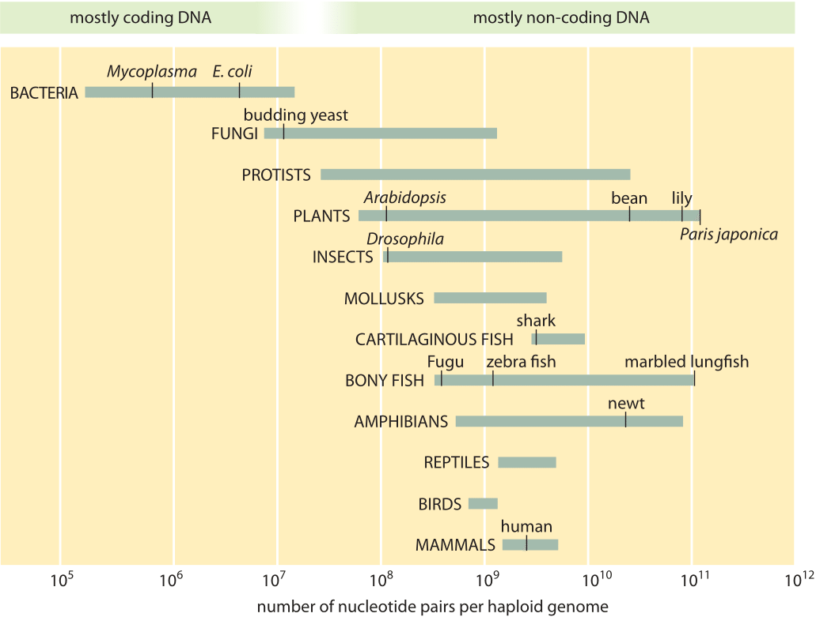
human genome

Slide 4
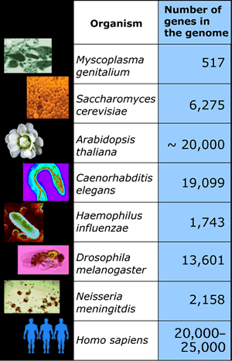

Slide 5
Genome Projects
Goals:
  Determine complete genome sequence of an organism
  Annotate protein-coding genes and other important genome-encoded features

Slide 6
Genome Projects
Goals:
  Determine complete genome sequence of an organism
  Annotate protein-coding genes and other important genome-encoded features
Projects:
  Over 15,000 genome projects in progress or completed

Slide 7


Genome Projects
Goals:
  Determine complete genome sequence of an organism
  Annotate protein-coding genes and other important genome-encoded features
Projects:
  Over 15,000 genome projects in progress or completed
Cancer Genomics
Shotgun Metagenomics

Slide 8
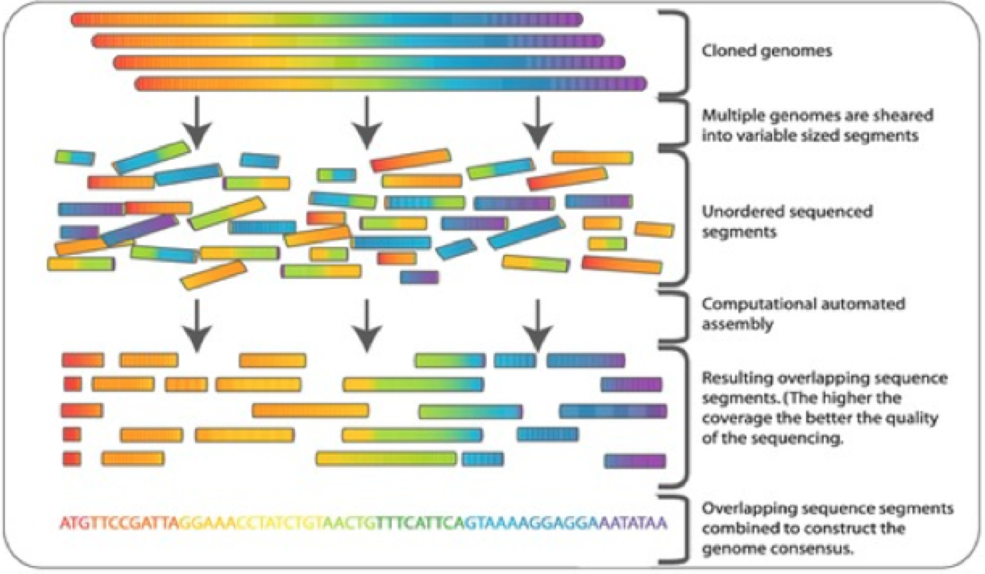
Genome Sequencing

Slide 9
Tale of Two Cities – Charles Dickens
It was the best of times, it was the worst of times, it was the age of wisdom, it was the age of foolishness, it was the epoch of belief, it was the epoch of incredulity, it was the season of Light, it was the season of Darkness, it was the spring of hope, it was the winter of despair, we had everything before us, we had nothing before us, we were all going direct to Heaven, we were all going direct the other way - in short, the period was so far like the present period, that some of its noisiest authorities insisted on its being received, for good or for evil, in the superlative degree of comparison only.

Slide 10
Shredded Book Reconstruction
Dickens accidently shreds first printing of Tale of Two Cities
  first printing = 5 copies
was the best of times,
wisdom, it was the age
It was the best of
age of wisdom, it was
it was the worst of
of wisdom, it was the
worst of times, it was…
it was the worst of
best of times, it was
wisdom, it was the age
It was the best of
best of times, it was
of wisdom, it was the
worst of times, it was…
age of wisdom, it was
it was the worst of
was the best of times,
It was the best of
age of wisdom, it was
was the best of times,
best of times, it was
it was the worst of
of wisdom, it was the
worst of times, it was…
wisdom, it was the age
It was the best of
age of wisdom, it was
was the best of times,
best of times, it was
it was the worst of
of wisdom, it was the
wisdom, it was the age
worst of times, it was…
was the best of times,
It was the best of
age of wisdom, it was
wisdom, it was the age
best of times, it was
it was the worst of
of wisdom, it was the
worst of times, it was…

Slide 11
Shredded Book Reconstruction
Dickens accidently shreds first printing of Tale of Two Cities
  first printing = 5 copies
  shredding was random (can cut between different words in each copy)
  always 5 words per fragment
It was the best of times, it was the worst of times, it was the
It was the best of times, it was the worst of times, it was the
It was the best of times, it was the worst of times, it was the

Slide 12
Shredded Book Reconstruction
Dickens accidently shreds first printing of Tale of Two Cities
  first printing = 5 copies
  shredding was random (can cut between different words in each copy)
  always 5 words per fragment
It was the best of times, it was the worst of times, it was the
It was the best of times, it was the worst of times, it was the
It was the best of times, it was the worst of times, it was the
5 copies x 138, 656 words/5 words per fragment = 138k fragments
All short fragments are mixed together

Slide 13
times, it was the age
It was the best of
age of wisdom, it was
best of times, it was
it was the age of
it was the age of
it was the worst of
of times, it was the
of times, it was the
of wisdom, it was the
the age of wisdom, it
the best of times, it
the worst of times, it
worst of times, it was
wisdom, it was the age
was the worst of times,
was the best of times,
was the age of foolishness,
was the age of wisdom
times, it was the worst

Slide 14
times, it was the age
It was the best of
age of wisdom, it was
best of times, it was
it was the age of
it was the age of
it was the worst of
of times, it was the
of times, it was the
the best of times, it
of wisdom, it was the
the age of wisdom, it
the best of times, it
the worst of times, it
worst of times, it was
wisdom, it was the age
was the worst of times,
was the best of times,
was the age of foolishness,
was the age of wisdom
times, it was the worst

Slide 15
times, it was the age
It was the best of
age of wisdom, it was
best of times, it was
it was the age of
it was the age of
it was the worst of
of times, it was the
of times, it was the
the best of times, it
of wisdom, it was the
best of times, it was
the age of wisdom, it
the best of times, it
the worst of times, it
worst of times, it was
wisdom, it was the age
was the worst of times,
was the best of times,
was the age of foolishness,
was the age of wisdom
times, it was the worst

Slide 16
times, it was the age
It was the best of
age of wisdom, it was
best of times, it was
it was the age of
it was the age of
it was the worst of
of times, it was the
of times, it was the
the best of times, it
of wisdom, it was the
best of times, it was
the age of wisdom, it
the best of times, it
the worst of times, it
worst of times, it was
wisdom, it was the age
was the worst of times,
was the best of times,
was the age of foolishness,
Assembly Parameter:
100% identify across 4 words
was the age of wisdom
times, it was the worst

Slide 17
times, it was the age
It was the best of
age of wisdom, it was
best of times, it was
it was the age of
it was the age of
it was the worst of
of times, it was the
was the best of times,
of times, it was the
the best of times, it
of wisdom, it was the
best of times, it was
the age of wisdom, it
the best of times, it
the worst of times, it
worst of times, it was
wisdom, it was the age
was the worst of times,
was the best of times,
was the age of foolishness,
Assembly Parameter:
100% identify across 4 words
was the age of wisdom
times, it was the worst

Slide 18
times, it was the age
It was the best of
age of wisdom, it was
best of times, it was
it was the age of
it was the age of
it was the worst of
It was the best of
of times, it was the
was the best of times,
of times, it was the
the best of times, it
of wisdom, it was the
best of times, it was
the age of wisdom, it
the best of times, it
the worst of times, it
worst of times, it was
wisdom, it was the age
was the worst of times,
was the best of times,
was the age of foolishness,
Assembly Parameter:
100% identify across 4 words
was the age of wisdom
times, it was the worst

Slide 19
times, it was the age
It was the best of
age of wisdom, it was
best of times, it was
it was the age of
it was the age of
it was the worst of
It was the best of
of times, it was the
was the best of times,
of times, it was the
the best of times, it
of wisdom, it was the
best of times, it was
the age of wisdom, it
of times, it was the
the best of times, it
of times, it was the
the worst of times, it
worst of times, it was
wisdom, it was the age
was the worst of times,
was the best of times,
was the age of foolishness,
was the age of wisdom
times, it was the worst

Slide 20
Tale of Two Cities – Charles Dickens
It was the best of times, it was the worst of times, it was the age of wisdom, it was the age of foolishness, it was the epoch of belief, it was the epoch of incredulity, it was the season of Light, it was the season of Darkness, it was the spring of hope, it was the winter of despair, we had everything before us, we had nothing before us, we were all going direct to Heaven, we were all going direct the other way - in short, the period was so far like the present period, that some of its noisiest authorities insisted on its being received, for good or for evil, in the superlative degree of comparison only.

Slide 21
times, it was the age
It was the best of
age of wisdom, it was
Repeats pile up – actual placement of each individual fragment unknown
best of times, it was
it was the age of
it was the age of
it was the worst of
It was the best of
of times, it was the
was the best of times,
of times, it was the
the best of times, it
of wisdom, it was the
best of times, it was
the age of wisdom, it
of times, it was the
the best of times, it
of times, it was the
the worst of times, it
worst of times, it was
wisdom, it was the age
was the worst of times,
was the best of times,
was the age of foolishness,
Assembly Parameter:
100% identify across 4 words
was the age of wisdom
times, it was the worst

Slide 22
times, it was the age
It was the best of
Repeats pile up – actual placement of each individual fragment unknown
Repeats can cause ambiguity and prevent proper assembly
age of wisdom, it was
best of times, it was
it was the age of
it was the age of
it was the worst of
It was the best of
of times, it was the
was the best of times,
of times, it was the
the best of times, it
of wisdom, it was the
best of times, it was
the age of wisdom, it
of times, it was the
the best of times, it
of times, it was the
the worst of times, it
times, it was the age
worst of times, it was
times, it was the worst
wisdom, it was the age
was the worst of times,
was the best of times,
was the age of foolishness,
Assembly Parameter:
100% identify across 4 words
was the age of wisdom
times, it was the worst

Slide 23
times, it was the age
It was the best of
Repeats pile up – actual placement of each individual fragment unknown
Repeats can cause ambiguity and prevent proper assembly
age of wisdom, it was
best of times, it was
it was the age of
it was the age of
it was the worst of
It was the best of
of times, it was the
was the best of times,
of times, it was the
the best of times, it
of wisdom, it was the
best of times, it was
the age of wisdom, it
of times, it was the
the best of times, it
of times, it was the
the worst of times, it
times, it was the age
worst of times, it was
times, it was the worst
wisdom, it was the age
was the worst of times,
It was the best of times, it was the [age/worst]
was the best of times,
was the age of foolishness,
Assembly Parameter:
100% identify across 4 words
was the age of wisdom
times, it was the worst

Slide 24
Genome Sequencing

Slide 25
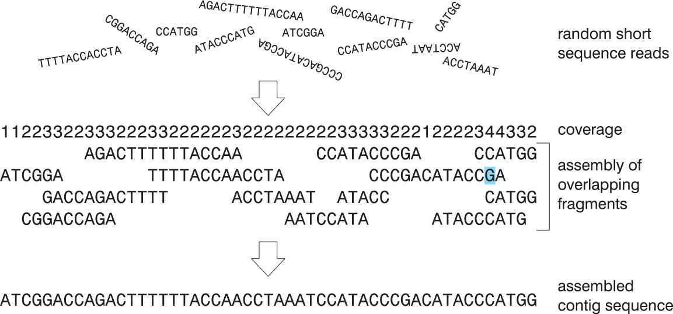
Coverage

Slide 26
Finding the Largest Overlap
Consider two fragment assembly:
  If there is more than one overlap, choose the longest overlap
  Assume the sequences are not identical
  Assume neither sequence is a substring of the other
  The longest possible overlap is length of the shorter sequence-1

Slide 27
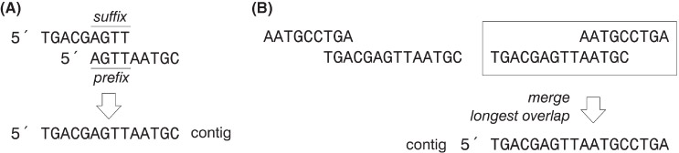
Finding the Largest Overlap
Start with s1 and s2
n = size of the smallest sequence – 1
Compare n suffix/prefix characters from s1 with n prefix/suffix characters s2
Count matching bases in the prospective overlap region. If the number of matches = n, found the largest overlap
If the number of matches < n, n = n-1 If n=0 – no overlap, go to step 3

Slide 28
Finding the Largest Overlap
Removing assumptions of identical subsequences and substrings:
  set the initial n to the length of the sequence rather than the length of the sequence – 1.

Slide 29
Dealing with Noisy Sequencing Data
Sequencing errors
Ambiguities leading to incorrect base-calling
Modify the algorithm so that the overlap exceeds some threshold value (instead of being perfect match)
  Check if the number of matching bases is threshold value x n
  With the threshold value being between 0 and 1

Slide 30
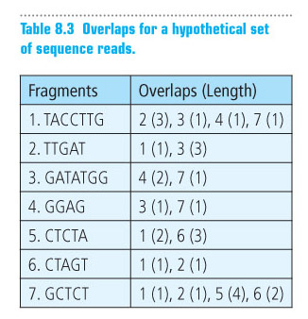
Assembling a Contig

Slide 31
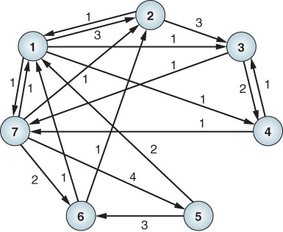
Assembling a Contig: graph representation

